Slide 1
COMP2013 CW Explanation
scyzy9@nottingham.ac.uk
Zhen Ye

Slide 2
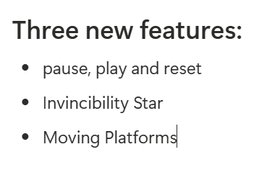
Part 1 Game Running & New feature
Compile and run using MVN：
mvn clean javafx:run

Slide 3
Part 1 Game Running & New feature
First, you can see the game successfully runs with JavaFX, compiling without errors.
Players use WASD for movement and space to shoot.
The game includes intelligent enemies, collision detection, and physics. Now let me demonstrate the three new features with their code implementation.

Slide 4
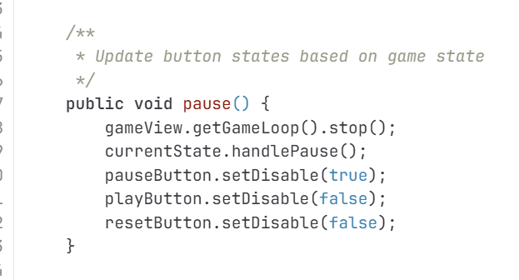
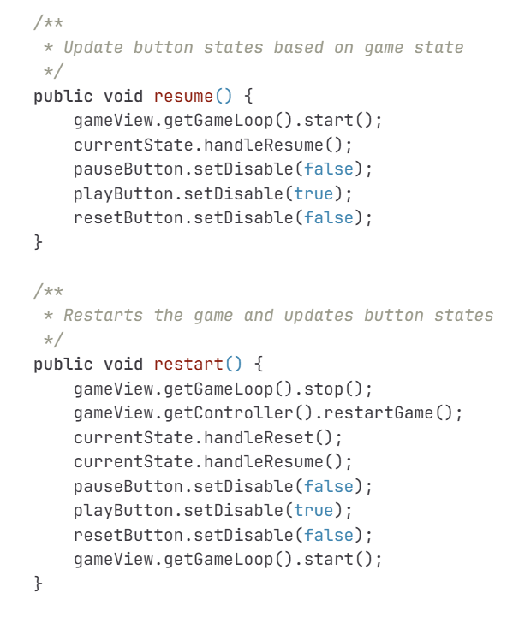
Part 1.1 - Pause,play and reset
view/StateView.java
When you click pause, the StateView's Pause() method stops the game loop and calls currentState.handlePause(). This triggers state transition.

Slide 5
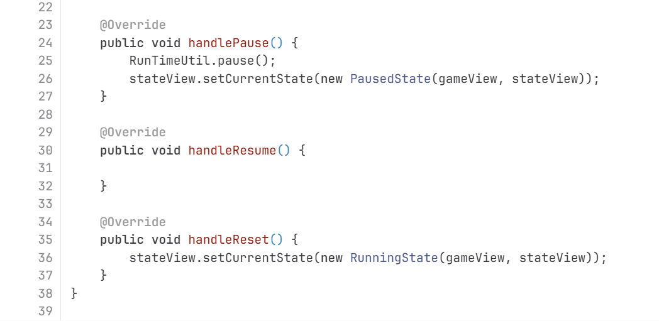
Part 1.1 - Pause,play and reset
Here,handlePause() calls RunTimeUtil.pause() to freeze time, then transitions to PausedState through setCurrentState().
controller/state/RunningState.java

Slide 6
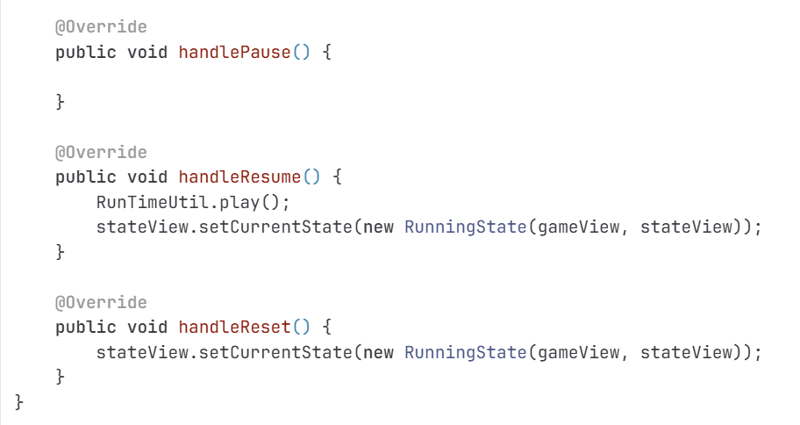
Part 1.1 - Pause,play and reset
Similarly, handleResume calls RunTimeUtil.play() and switches back to RunningState.
controller/state/PausedState.java

Slide 7
Part 1.2 - Invincibility star
Feature Two: Invincibility Star Power-up using the Strategy Pattern.
When the player touches this star block, they gain 30 seconds of invincibility and the star disappears.

Slide 8
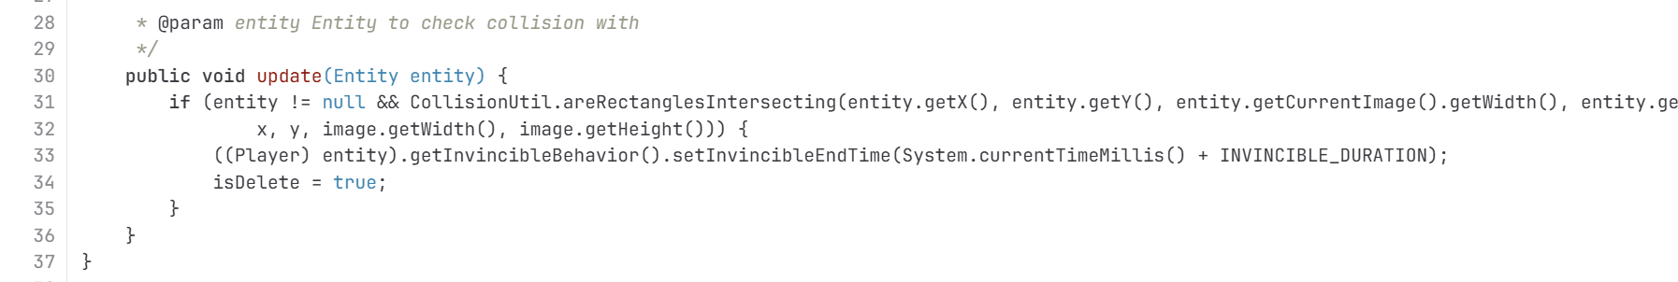
Part 1.2 - Invincibility star
model/entities/StarMapBlocks.java
In update() method, it checks collision with the player. If colliding, line 33 calls: player.getInvincibleBehavior().setInvincibleEndTime with current time plus 30 seconds. Then it marks itself for deletion.

Slide 9
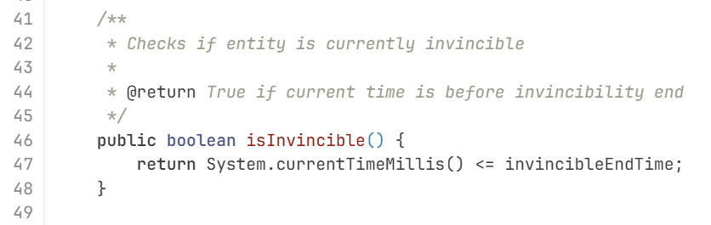
Part 1.2 - Invincibility star
model/behavior/InvincibleBehavior.java
Here, isInvincible() method checks if current time is before the invincibleEndTime.

Slide 10
Part 1.3 - Moving Platforms
Feature Three: Moving Platforms using Inheritance and Polymorphism.
These platforms move horizontally, and players move with them when standing on top.

Slide 11
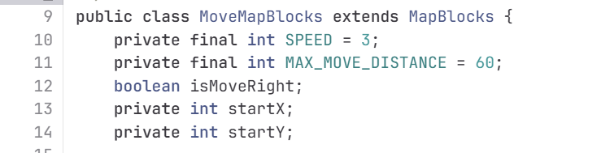
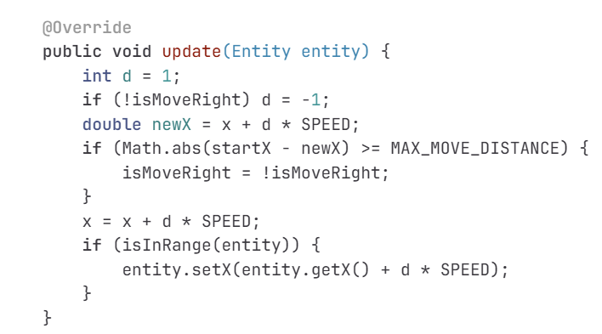
Part 1.3 - Moving Platforms
MoveMapBlocks extends MapBlocks and adds movement properties: speed of 3 pixels, maximum pixels, startX and startY to track the starting position.
In the update() method, it moves in the current direction. When reaching maximum from start position, it reverses by toggling isMoveRight().
model/entities/MoveMapBlocks.java

Slide 12
Part 2 - Code Architecture
My final architecture follows the standard MVC pattern.
The Model layer contains the main game logic.
The View layer is responsible for graphic rendering.
The Controller layer controls the game state and input.
This architecture achieves high cohesion and low coupling,
with clear responsibilities for each layer, making it easy to test and extend.

Slide 13
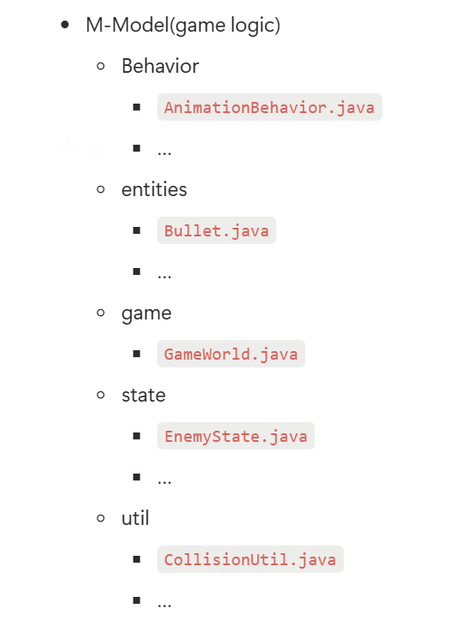
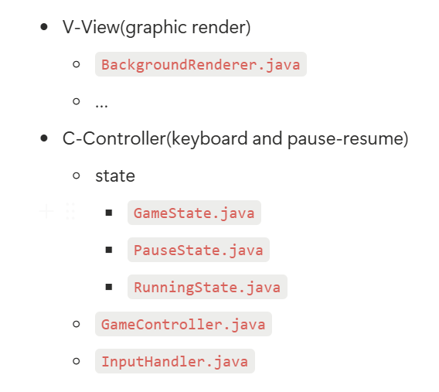
Part 2 - Code Architecture

Slide 14
Part 3 - Code principles
My code demonstrates three fundamental principles: SOLID principles, Object-Oriented design, and DRY.

Slide 15
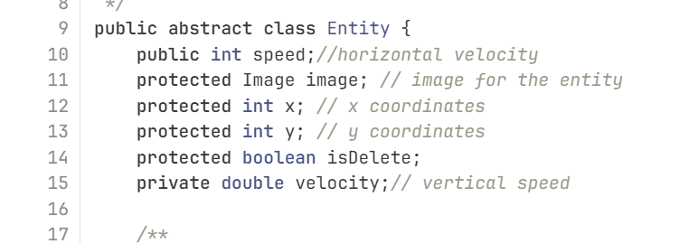
Part 3.1 - SOLID
First, SOLID principles, specifically Single Responsibility and Open-Closed.
V1's entity class violates Single Responsibility—it has 10+ properties handling physics, health, animation, input, and ammunition all in one class.
V3's Entity has far less essential properties.
model/entities/Entity.java

Slide 16
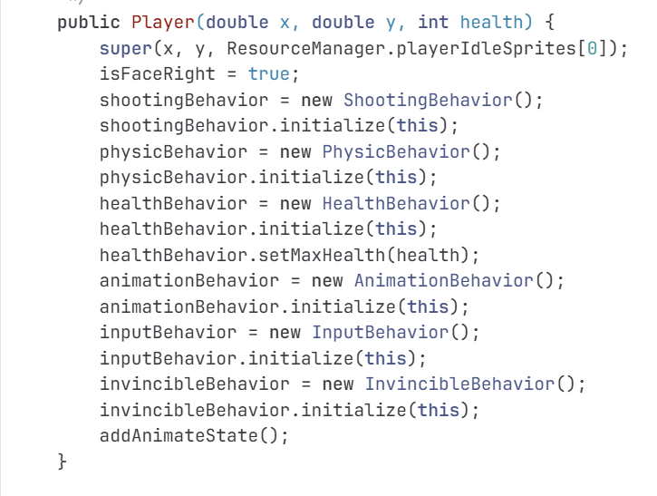
Part 3.2 - OO
Second, Object-Oriented design, specifically Composition over Inheritance. I use composition Instead of inheritance hierarchies. Player composes 6 independent behaviors:shooting, physics, health, animation, input, invincibility.
model/entities/Player.java

Slide 17
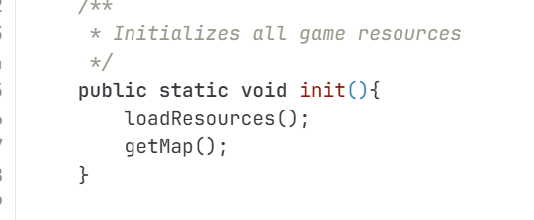
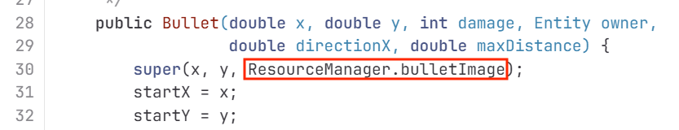
Part 3.3 - DRY - Don't Repeat Yourself
In V1, Same try-catch blocks repeated everywhere. If the loading mechanism needs to change, I'd have to modify a great many lines.
V3 avoids this with ResourceManager.
One init() method loads everything.
model/util/ResourceManager.java

Slide 18
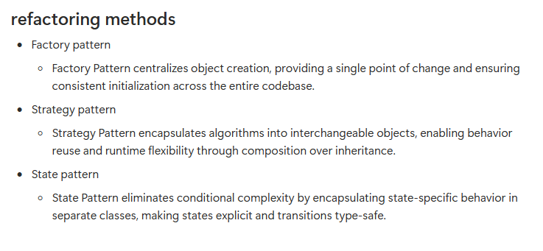
Part 4 - Refactoring methods

Slide 19
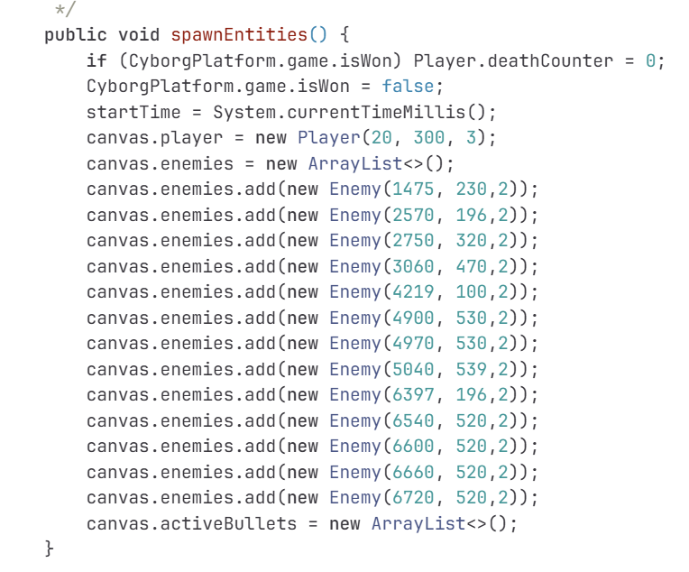
Part 4.1 - Factory pattern
In V1, entities were created directly throughout the code. Look at the spawnEntities() method — lines of repeated Enemy creation.And Player creation was also scattered with direct instantiation.
This violates the Single Responsibility Principle.
If I need to change how enemies are initialized, add behaviors or change health,I'd have to find and modify every single creation point.
src/main/java/Game.java

Slide 20
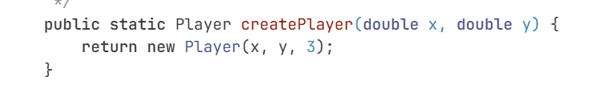
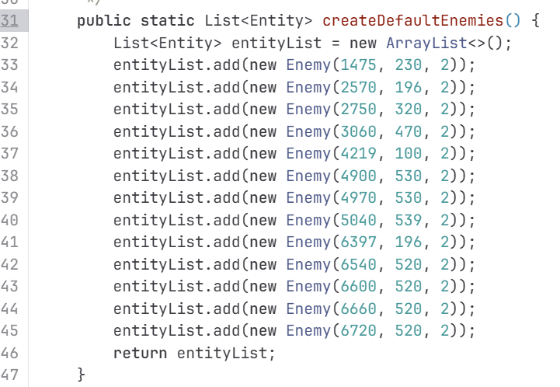
Part 4.1 - Factory pattern
In v3, I created EntityFactory with static factory methods. The createPlayer() method encapsulates all player creation logic. It takes just x, y coordinates and returns a fully configured Player with all 7 behaviors initialized.createDefaultEnemies() returns a list of 13 pre-configured enemies.All the positioning logic is centralized here.
model/util/EntityFactory.java

Slide 21
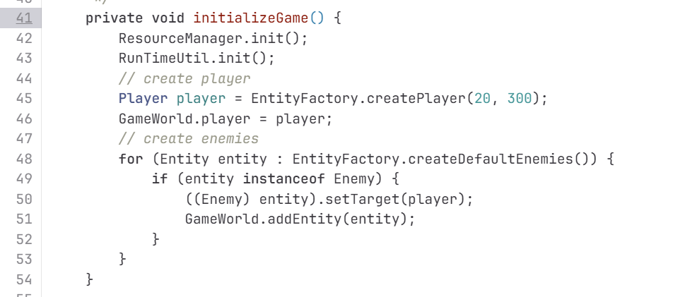
Part 4.1 - Factory pattern
Now in GameController, entity creation is incredibly simple: Player player = EntityFactory.createPlayer(20, 300); One line. Clean, and Readable.
This demonstrates the Factory Pattern's three key benefits:First, Encapsulation—creation logic is hidden.Second, Single Point of Change—if I need to modify enemy health or add new behaviors, I change it once in the factory.Third, Consistency—all entities are created the same way,reducing bugs from inconsistent initialization.
controller/GameController.java

Slide 22
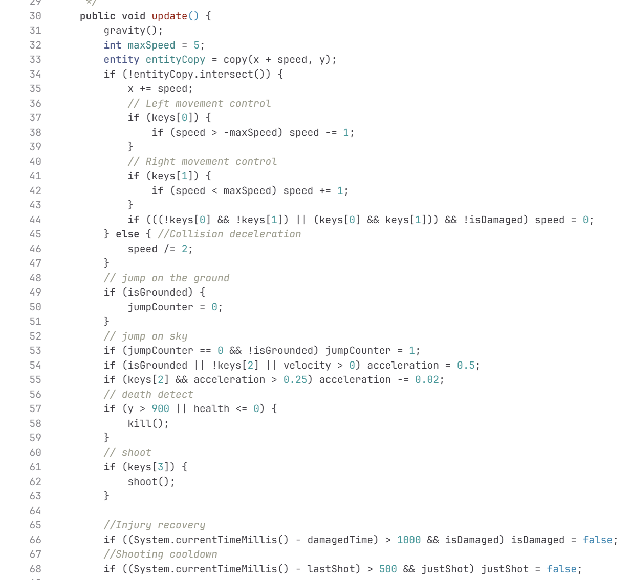
Part 4.2 - Strategy Pattern
The second major refactoring was implementing the Strategy Pattern through the Behavior system.V1's Player had a complex update() method with 40+ lines of code.It handled gravity, collision, input, jumping, shooting, damage—everything mixed together.This makes the code impossible to reuse.If I want a different enemy with similar movement but different attack,I'd have to copy and modify lots of code.This violates both Single Responsibility and Open-Closed Principles.
src/main/java/Player.java

Slide 23
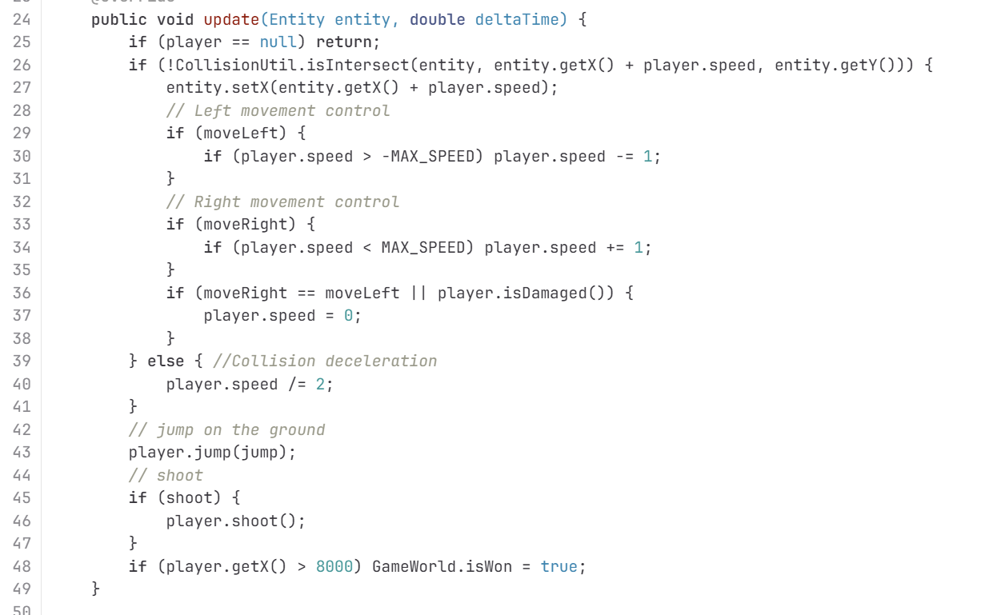
Part 4.2 - Strategy Pattern
Here I extracted all behaviors into a common Strategy interface.Just two methods: initialize and update.InputBehavior() encapsulates all player input logic.It maintains input states and translates them into entity actions in the update() method.
Also, Player.java composes 6 different behaviors.Each behavior is a strategy that can be mixed and matched.
model/behavior/InputBehavior.java

Slide 24
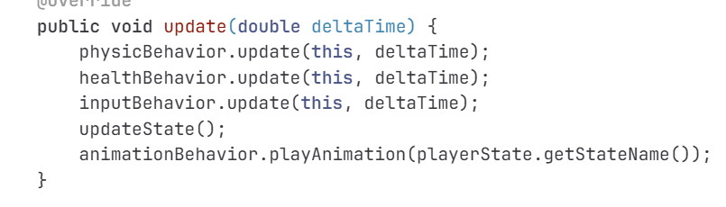
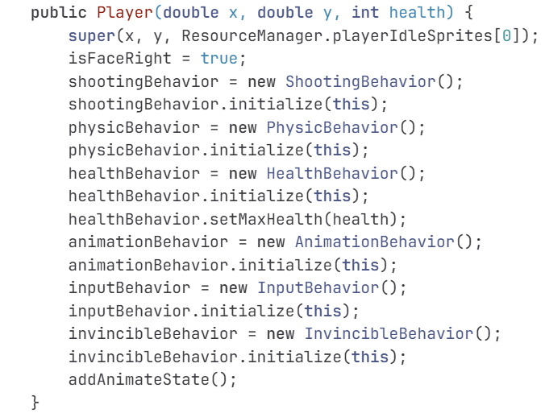
Part 4.2 - Strategy Pattern
Now Player's update() is just 7 lines— one call to each behavior's update method.This is the Strategy Pattern in action.Each behavior encapsulates an algorithm.Player can swap behaviors at runtime if needed.
Most importantly, behaviors are reusable.If I want Enemy to shoot, I just add ShootingBehavior() to Enemy.This achieves high cohesion and low coupling.
model/entities/Player.java

Slide 25
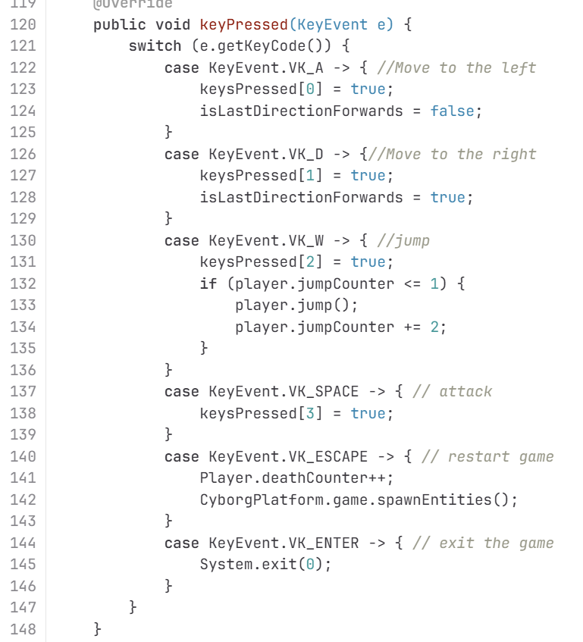
Part 4.3 - State Pattern
The third major refactoring was implementing the StatePattern for game state management.V1 had no proper state management.Game control relied entirely on keyboard events.ESC key restarts the game, ENTER exits—all handled through scattered if-else statements.Also,in paint(), there was no pause functionality.No way to resume after pausing.State transitions were implicit and hard to track.
model/entities/Player.java

Slide 26
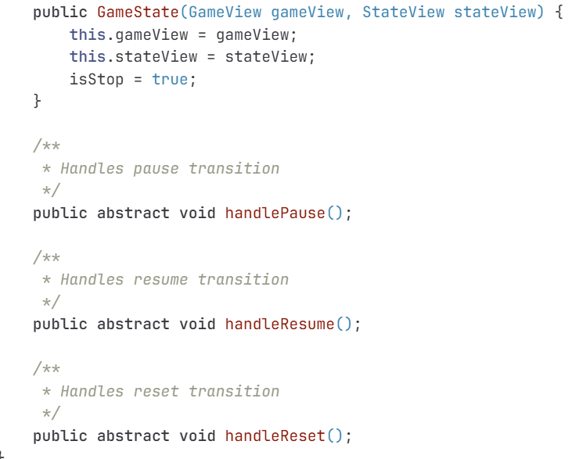
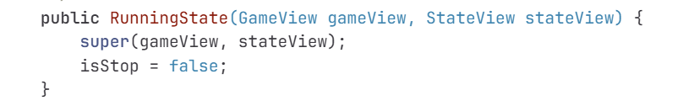
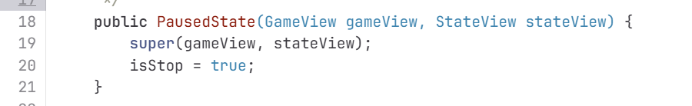
Part 4.3 - State Pattern
controller/state/RunningState.java
controller/state/PausedState.java
controller/state/GameState.java
I created an abstract GameState class defining three transitions:handlePause(), handleResume(), and handleReset().
RunningState represents the active game.When handlePause() is called, it pauses the game timer and transitions to PausedState.

Slide 27
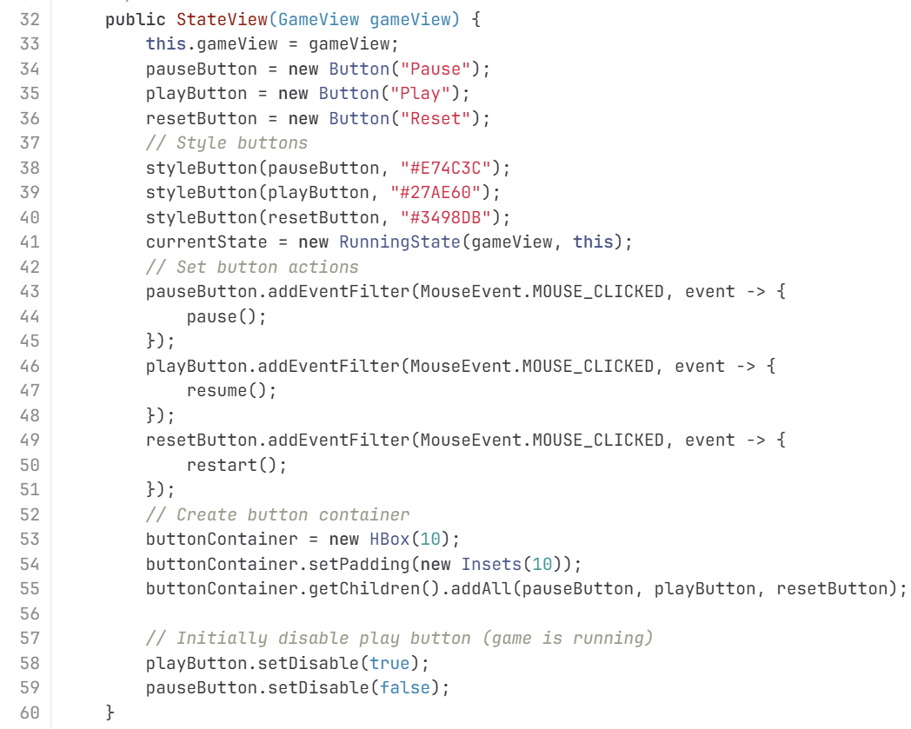
Part 4.3 - State Pattern
In State Pattern, behavior changes base on internal state.Three key benefits: First, RunningState() and PausedState() are concrete classes, not boolean flags.Second,Localized Behavior.Each state's logic is encapsulated in its own class.Third, Easy extension—to add MenuState() or LoadingState(),I just extend GameState. No modification of existing code.This eliminates conditional complexity and follows the Open-Closed Principle.

